Slide 1
The likely future changes in the nature and spatial distribution of the production and consumption of tourism.
Syllabus Point.

Slide 2
The growth of the tourism industry since 1945 has been explosive. The future pace and direction of this growth will be determined by:
Affordability: the propensity to travel will remain closely aligned to prevailing economic conditions, the fastest potential growth is in newly industrialised countries. For example, Asia, with its massive population and rising affluence, has been a boom for the Australian tourism industry.

Slide 3
The growth of the tourism industry since 1945 has been explosive. The future pace and direction of this growth will be determined by:
Accessibility: as transport technology makes long haul flights more affordable, a growing proportion of the population will be able to participate in international travel. The destinations will reflect perceived security. Places experiencing political and civil instability will be avoided.

Slide 4
The growth of the tourism industry since 1945 has been explosive. The future pace and direction of this growth will be determined by:
Accommodation: tourists will continue to be drawn to the destinations that best meet their needs. The tourism industry is attempting to provide travel experiences to meet every budget and every situation. Specials for seniors, young families, singles are available as the market diversifies to accommodate all demands.

Slide 5
The growth of the tourism industry since 1945 has been explosive. The future pace and direction of this growth will be determined by:
Attractions: technology will continue to develop and enhance the tourism experience.

Slide 6
The growth of the tourism industry since 1945 has been explosive. The future pace and direction of this growth will be determined by:
It is also likely there will be fewer barriers to international travel. Tourists will be courted by both developed and developing nations for the economic benefits that come from tourism and for the benefits realised from a heightened awareness and appreciation for natural and cultural diversity.

Slide 7
“Tourism is the force that will make the global village truly one world. Already, regional partnerships are forming around the globe in recognition of tourism’s enormous economic potential and the need to remove barriers to growth… it will be possible for anyone to book an airline, a car rental and hotel reservations from their home computer as the world’s computer reservation systems converge, creating a seamless global tourism-information network. With explosive growth in tourism and with traveller’s increased sophistication, the demand for information will encourage the growth in consortia, which will lead to ever-greater interconnectivity. To remain linked to one or more reservation systems. Ultimately, these systems will be linked to one another, creating a complete information network and a truly global industry.” J. Naisbitt, Global Paradox, 1994.

Slide 8
Implications of the changes in the nature and spatial distribution of the production and distribution tourism for people, places and the biophysical environment at a variety of scales, including the local.
Syllabus Point.

Slide 9
Biophysical Impacts
Tourism developments tend to be located near attractive or unique features of the biophysical environment. Unfortunately however, exploitation for tourism often places a heavy strain on such natural resources. The greatest threat exists to those natural environments considered to be the most fragile, that is, most vulnerable to natural or human induced stress.

Slide 10
Biophysical Impacts
Without careful management, intensive tourism development can contribute to the deterioration of air and water quality and the destruction of the natural landscape. Damage to vegetation. Trampling, fire and removal or species as well as threats to wildlife from hunting, disruption to feeding and breeding, restrictions on movement and loss of natural habitat.

Slide 11
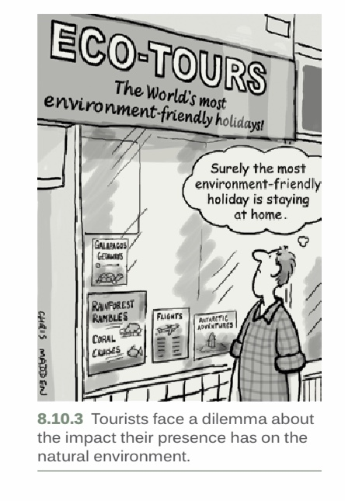

Slide 12
Social Impacts of Tourism
Social contact between tourists and residents can be mutually beneficial
The resident population can gain a greater understanding of visitors custom (business), values and cultures as well as enjoying an increased demand for traditional entertainments, thereby preserving parts of the national heritage
Tourists patronage of museums, art galleries and theatres brings revenue and maintains these facilities for local use as well

Slide 13
Social Impacts of Tourism
Increasing numbers of tourists can mean a shift in this attitude however, from initial euphoria to growing hostility
Tourism development may promote mutual misunderstanding, hostility and social tension as resident’s lifestyles are affected by the demands of tourists.
One of the most significant and least desirable impacts of tourism is growth in crime, gambling and other negative activities in the host population.

Slide 14


Slide 15
Social Impacts of Tourism
If such problems are not addressed through social policy or provision of community services, hostility and anger towards tourists may build, especially if money is drained from the host country because of foreign ownership of tourist resorts.
Outright hostility may emerge, which could reduce tourist flows and threaten the viability of the industry.

Slide 16
Unit 8.10 Tourism: The Issues pages 322
Read and complete activities 1 – 6, 8, 9

Slide 17
The impact of these changes on less developed countries (LDC) in terms of sustainability.
Syllabus Point.

Slide 18
Social Impacts of Tourism
Tourism in many developing and least developed countries is the most viable and sustainable economic development option, and in some countries, the main source of foreign exchange earnings. Part of this income trickles down to different groups of the society and, if tourism is managed with a strong focus on poverty alleviation, it can directly benefit the poorer groups through employment of local people in tourism enterprises, goods and services provided to tourists, or the running of small and community-based enterprises, etc., having positive impacts on reducing poverty levels.

Slide 19
Social Impacts of Tourism
Tourism in the recent years has been characterized by two main trends; firstly, the consolidation of traditional tourism destinations, like those in Western Europe and North America; and secondly, a pronounced geographical expansion. There has been a substantial diversification of destinations, and many developing countries have seen their tourist arrivals increase significantly. Arrivals to developing countries accounted for 46% of the total international arrivals in 2011. Tourism has become a major player in the economy of developing countries.

Slide 20
Social Impacts of Tourism
Here are some facts:
In 2011, international tourism arrivals to emerging market and developing countries amounted to 459 million.
Tourism is the first or second source of export earnings in 20 of the world’s 48 least developed countries .
In some developing countries, notably small island states, tourism can account for over 25% of GDP.

Slide 21
Social Impacts of Tourism
Impact on life-supporting resources. These include water, land, food, energy sources and biodiversity. Their availability to the poor can be threatened by competition and over use from tourism. Global issues of resource depletion and environmental degradation may be as important as local ones, including the long term effect of tourism on climate change and the impact of adaptation and mitigation measures on travel patterns.

